Slide 1
Experiments in the Wild: Public Evaluation of Off-Screen Visualizations in the Android Market
Niels Henze and Susanne Boll University of Oldenburg forename.lastname@uni-oldenburg.de Benjamin Poppinga OFFIS – Institute for Informatics benjamin.poppinga@uni-oldenburg.de

Slide 2
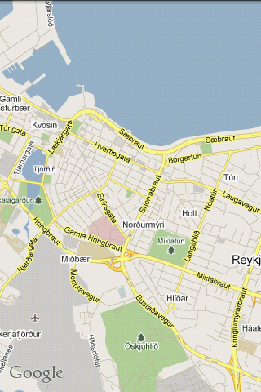
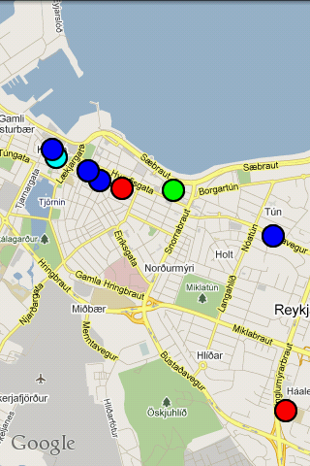
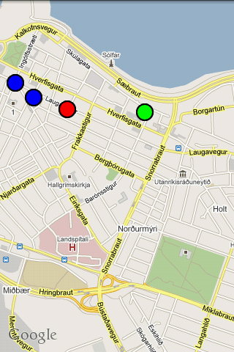
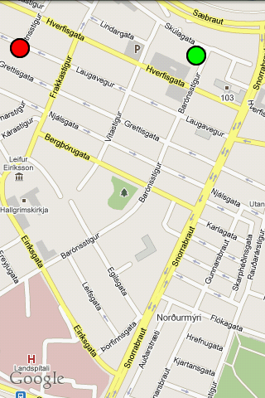
Any pubs in Reykjavik?

Slide 3
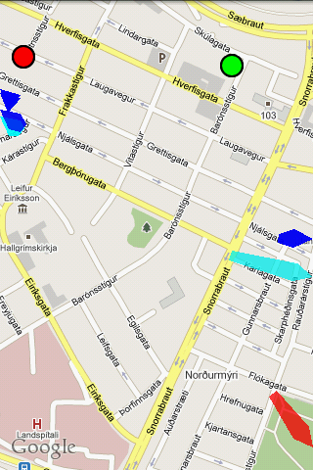
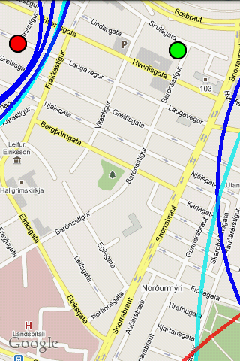
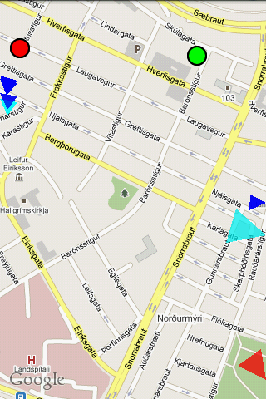
Visualizing the off-screen for digital maps

Slide 4
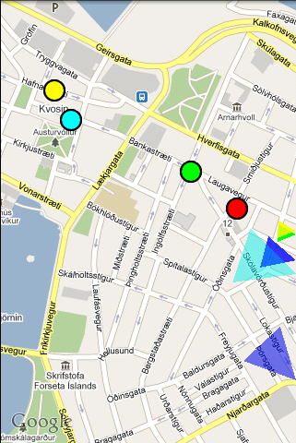
Halos, scaled arrows & stretched arrows

Slide 5
Previous work...
Compared Halo with arrows (Baudisch et al. 2003)
Lab study with 11.5 participants
Static map
Halo wins
Compared three different off-screen visualizations (Burigat et al. 2006)
Lab study with 17 participants
Static map
Arrows win

Slide 6
...but we only wanted to know which one is best
to adapt a visualization for handheld Augmented Reality
Our study should
have results that can be generalized beyond computer science students,
not only be applicable for controlled situations in a lab,
allow participants to dynamically interact with the map,
and not cost much effort.

Slide 7
A mobile game as an Apparatus
Defined tasks
Easy to measure performance
Task repetition is common
People like to play

Slide 8
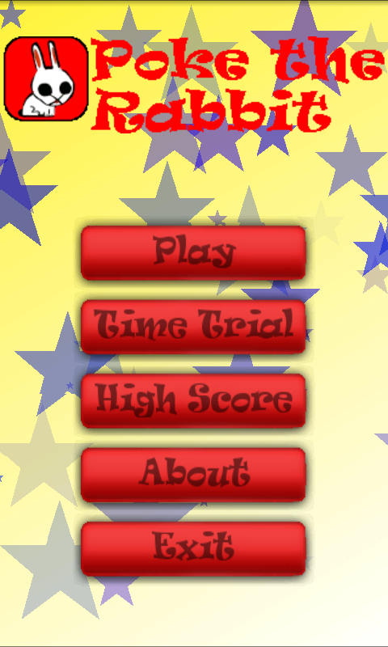
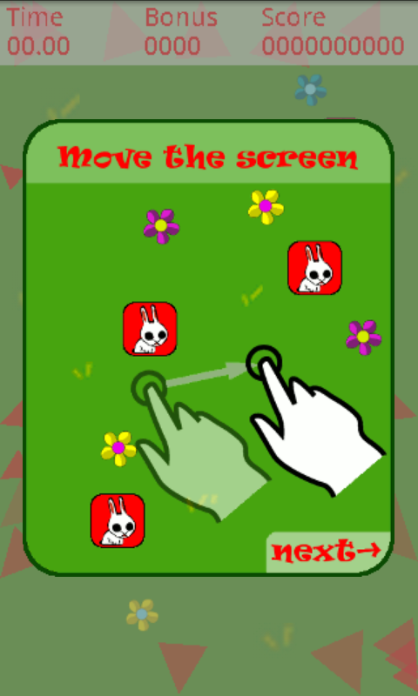
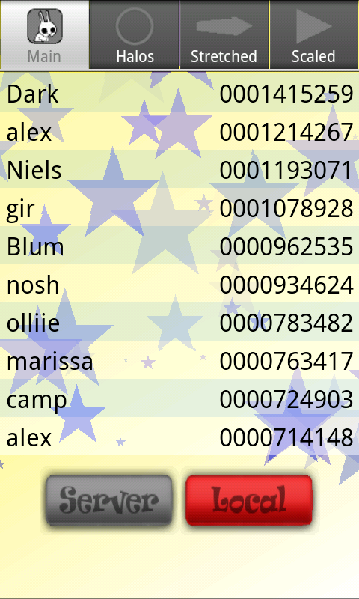
Poke the Rabbit

Slide 9
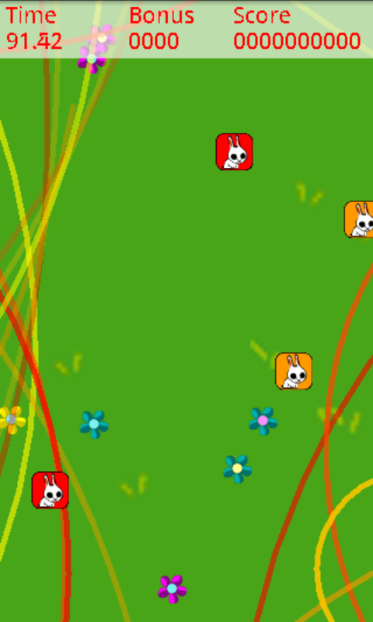
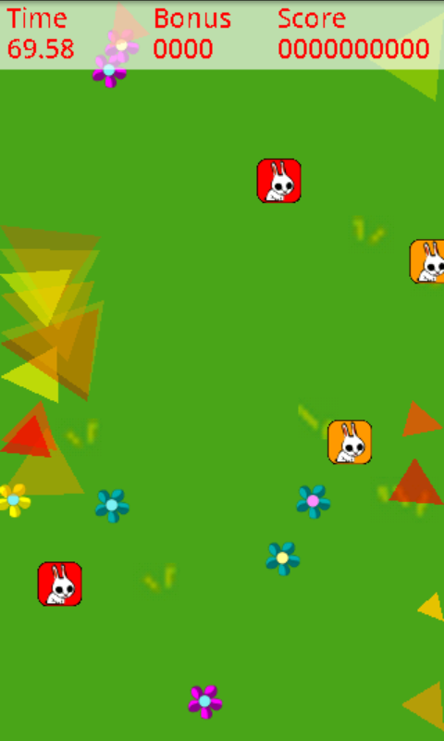
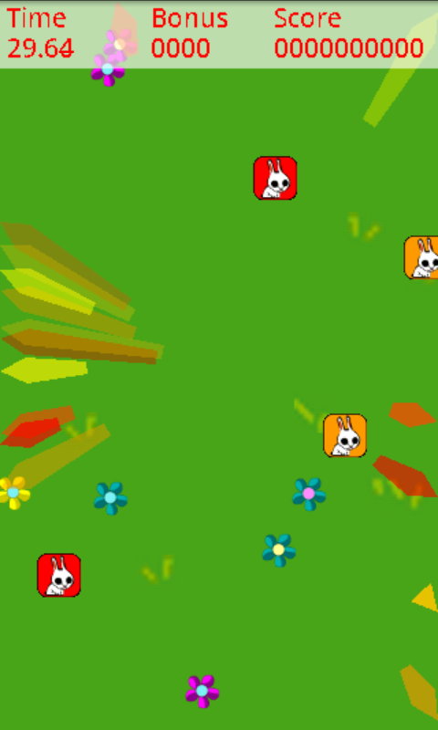
Three conditions

Slide 10
Published in the Android Market
5.5 month in the Android Market
5,708 installs
Feedback from 5,103 devices

Slide 11
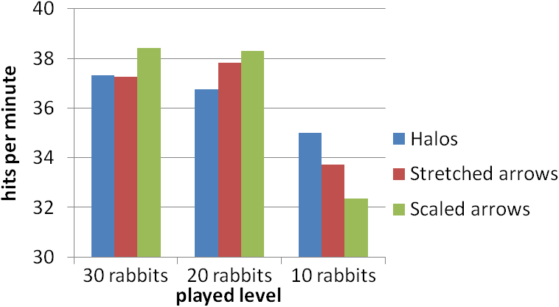
Results: It depends

Slide 12
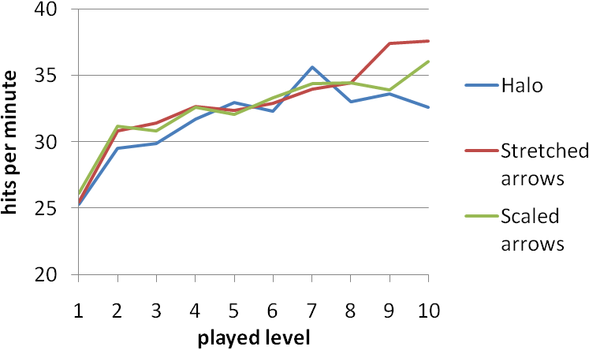
Learning effects?

Slide 13
Qualitative feedback
Realy stupid
hope
Stupid waste of time!!!
cailan
FC the rabbit.... uninstalled
Godimus Prime
Its ok
erika
Stupid and offincive
to my pet rabbit bayleigh
Logan
Stupid waste of time.
lance
boring and dumb.
Beba
What the hell is this??
Luci
1 word...... dumb!
josue
5 stars if there is a way to turn the music off.
Doesnt go to well with slipknot
Allen
Boo!
Cullen Girl

Slide 14
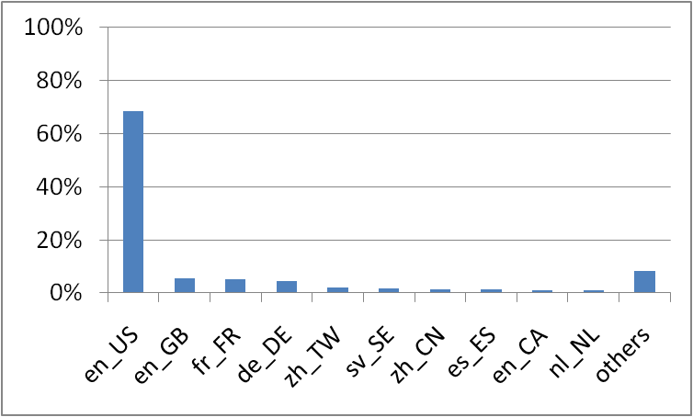
English speaking guys from the US

Slide 15
Acquiring participant
How to ask people
if they want to participate?
We didn‘t….

Slide 16
Conclusion
Games in App Stores can be used to upscale HCI experiments
Collect results before people realize that it sucks
Not necessary that people love it
Large numbers don’t overcome design flaws
Users don’t reflect the global population

